Slide 1
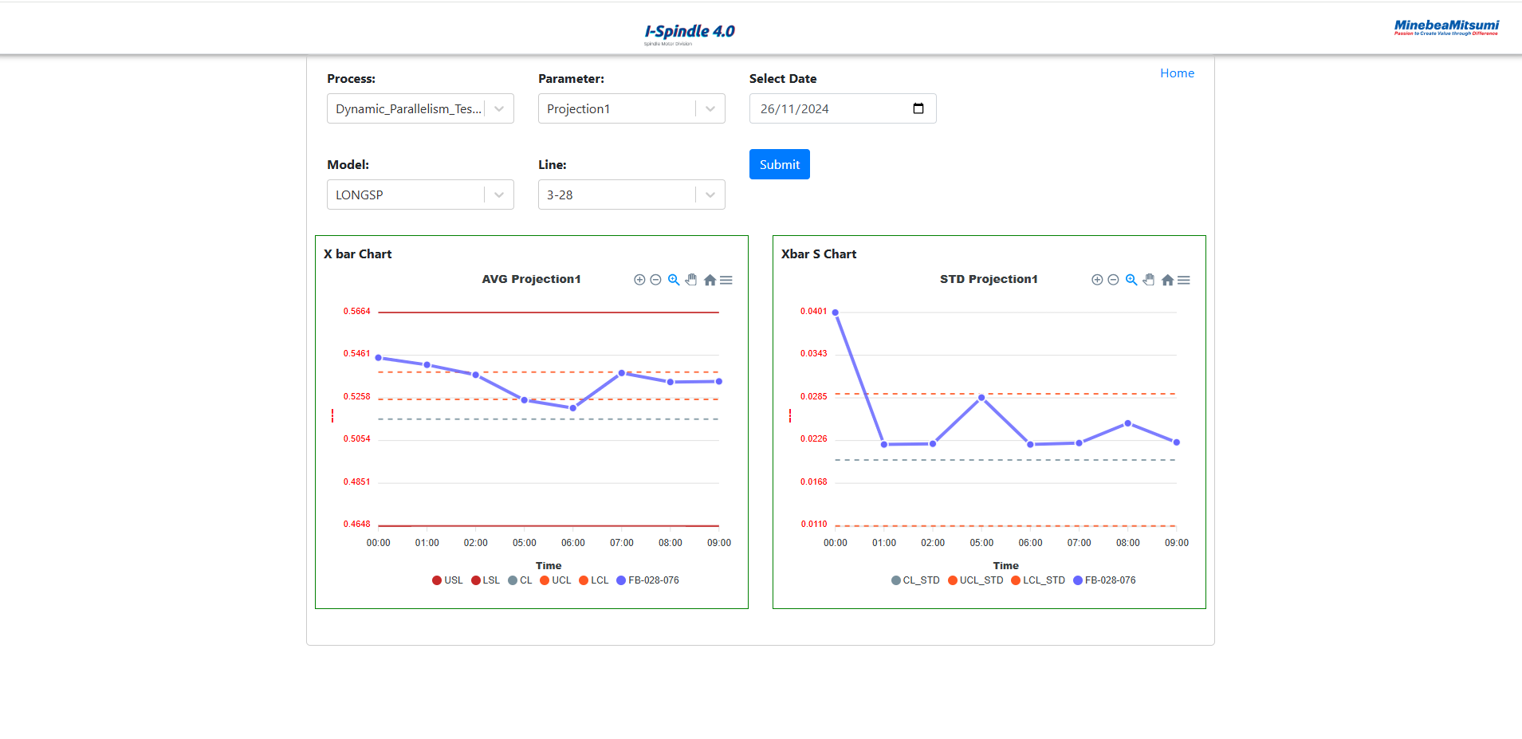
Page SPC

Slide 2
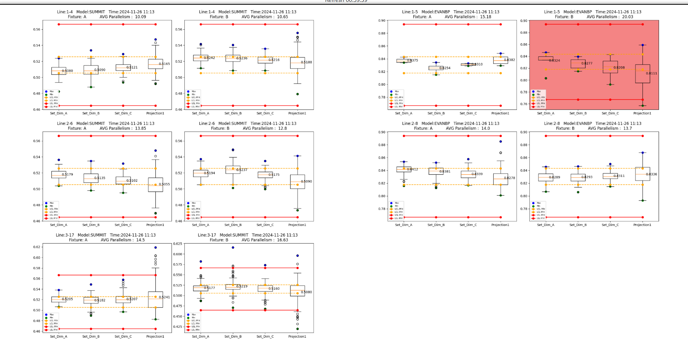
Dashboard Boxplot Machine: If the AVG exceeds the Control, make it red.

Slide 3
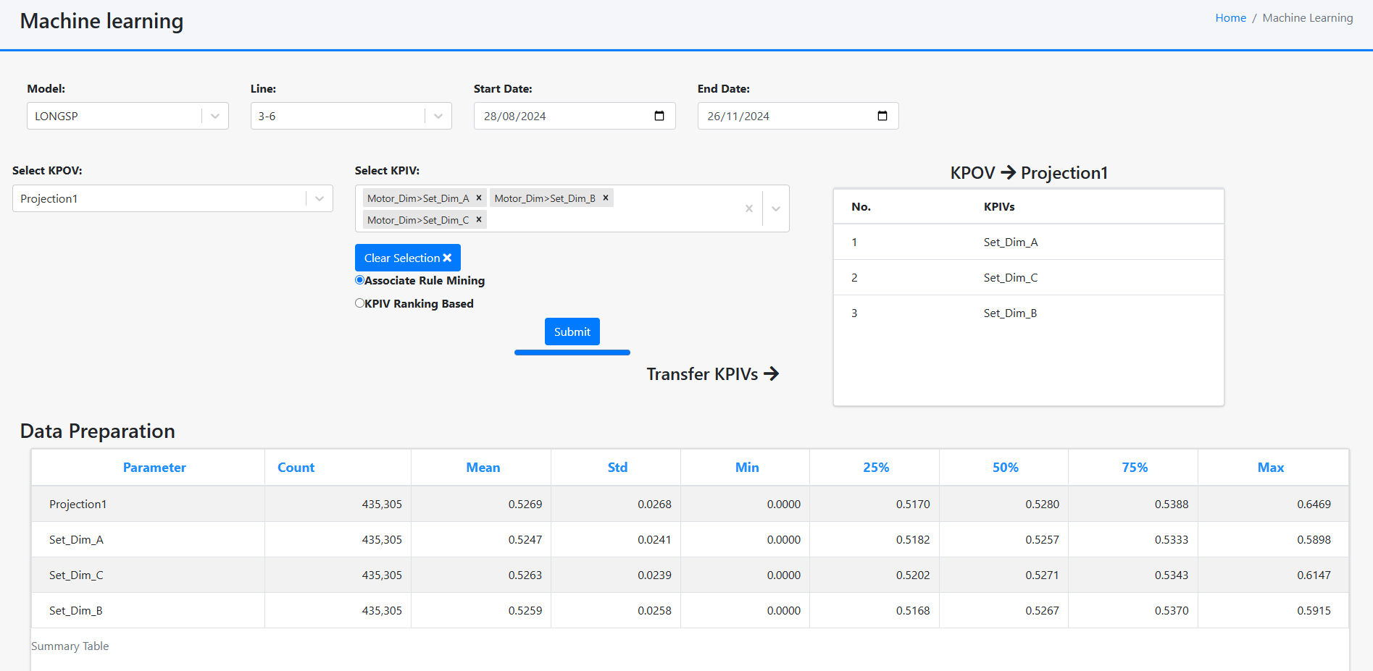
Machine learning pulls data from the database to predict which KPIVs influence specific KPOVs.

